Slide 1
Challenges
Mini challenge 3

Slide 2
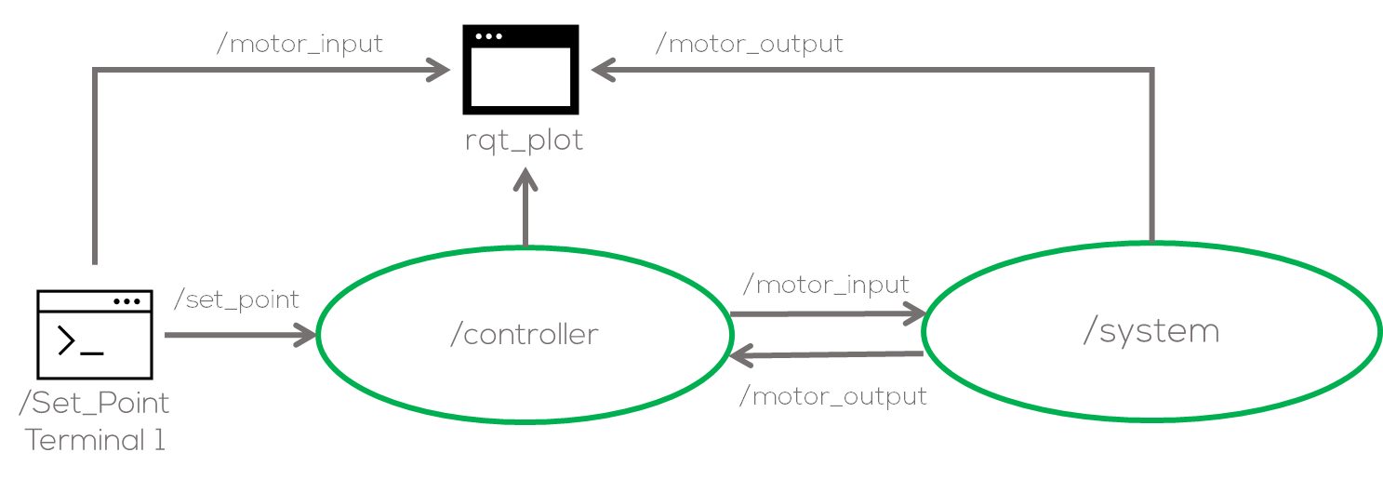
Mini Challenge 2
Introduction
This mini challenge is intended for the student to review the concepts introduced in the previous sessions.
The activity consists of creating a controller for a simple first order system (/system) in ROS. The system represents the dynamical behaviour of a DC Motor.
The “/system” node, and a simple program structure (not mandatory) are provided by MCR2.
The controller can be “P”, “PI” or “PID” controller (other controllers can be accepted upon agreement with the professor.).

Slide 3
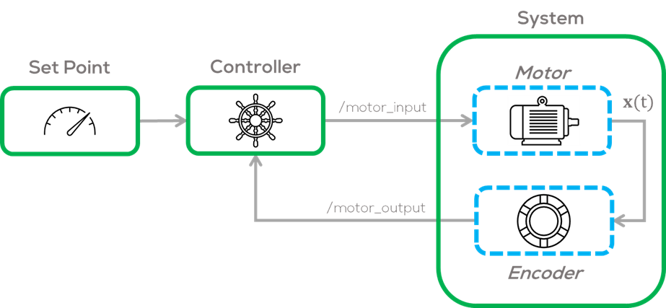
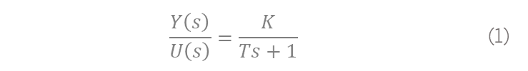
Mini Challenge 2
System node.
The “process node” is a node made by MCR2, that simulates a first order system of the form
Approximating a simple DC Motor with an encoder.
The input and output of the node are custom messages made specifically for this system. The student must use these messages to communicate with the system.
The messages are in the folder “msg”.
$$\frac{Y\left(s\right)}{U\left(s\right)}=\frac{K}{Ts+1}$$ | (1)
Motor input message:
float32 input #Input to the system
float64 time #Simulation time to be sent to the system
Motor output message:
float32 output #Output of the system
float64 time #Time stamp of the system
string status #Status of the motor “Turning”, “Not Turning”, “Max Speed”

Slide 4
Mini Challenge 2
System node
The system parameters can be found in “”config/system_params.yaml”.
The parameters names are based on Eq. 1.
It is suggested that for this exercise the parameters remain unchanged.
Hints
It is encouraged to test the system before using it with the controller.
The system can be tested by using ROS command line tools as follows.
system_node_rate : 100 #Node Rate in HZ
system_sample_time : 0.02 #System Sample time
system_param_K : 1.75 #Gain parameter K
system_param_T : 0.5 #Time constant parameter T
system_initial_cond : 0.0 #System initial conditions
system_max_speed : 13.0 #Max Speed of the system (Saturation)
system_min_input : 0.5 #Minimum input (Dead-Zone)
Terminal 1:
roscore
Terminal 2:
rosrun pid_control system.py
Terminal 3: (plot the output /motor_output/ouput)
rosrun rqt_plot rqt_plot
Terminal 4:
Rostopic /pub /motor_input pid_control/motor_input “input:7.0 time:0.0”

Slide 5
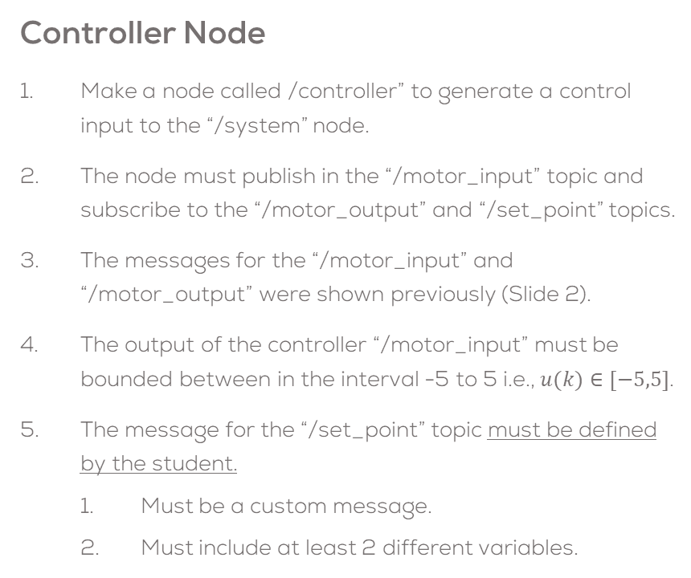
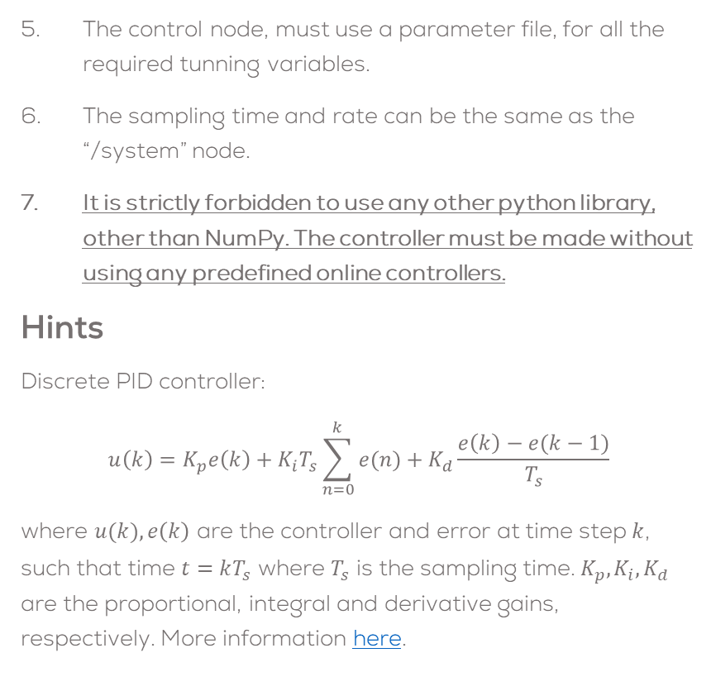
Mini Challenge 2
The control node, must use a parameter file, for all the required tunning variables.
The sampling time and rate can be the same as the “/system” node.
It is strictly forbidden to use any other python library, other than NumPy. The controller must be made without using any predefined online controllers.
Hints
Discrete PID controller:
$$u\left(k\right)=K_{p}e\left(k\right)+K_{i}T_{s}\sum_{n=0}^{k}{e(n)}+K_{d}\frac{e\left(k\right)−e(k−1)}{T_{s}}$$
where $u(k),e\left(k\right)$ are the controller and error at time step $k$, such that time $t=kT_{s}$ where $T_{s}$ is the sampling time. $K_{p}, K_{i}, K_{d}$ are the proportional, integral and derivative gains, respectively. More information here.
Controller Node
Make a node called /controller” to generate a control input to the “/system” node.
The node must publish in the “/motor_input” topic and subscribe to the “/motor_output” and “/set_point” topics.
The messages for the “/motor_input” and “/motor_output” were shown previously (Slide 2).
The output of the controller “/motor_input” must be bounded between in the interval -5 to 5 i.e., $u(k)∈[−5,5]$.
The message for the “/set_point” topic must be defined by the student.
Must be a custom message.
Must include at least 2 different variables.

Slide 6
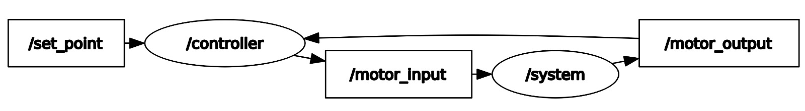
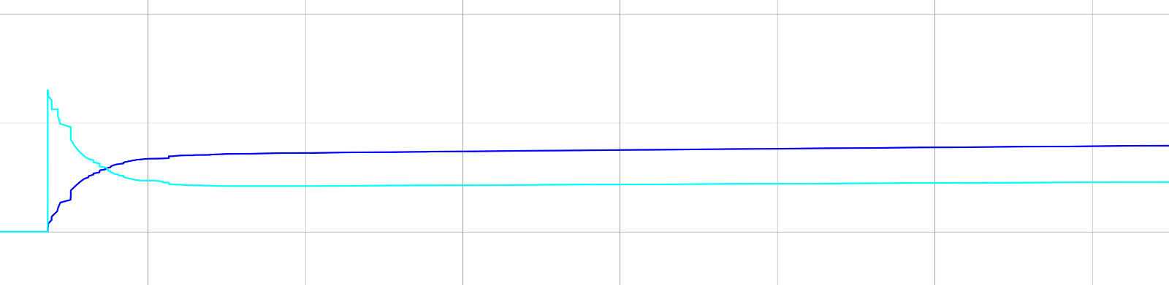
Mini Challenge 2
Launch File and Plotting
Use the ROS tool “rqt_plot” to plot both signals.
Make a Launch file to execute both nodes at the same time.
The Launch file must be able to all the required terminals to print the information.
The Launch file must open the rqt_plot and plot all required signals in the same window.
The launch file must load the parameter files, automatically.
Expected Results

Slide 7
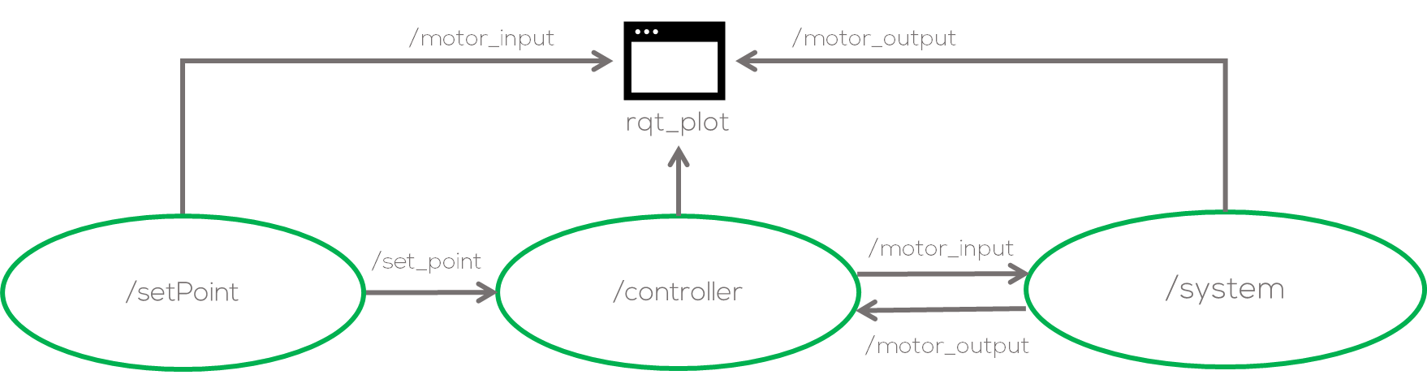
Mini Challenge 2 (Extension)
Instructions
Use and modify the previously developed “/signal_generator” node (Mini challenge 1) to generate a Set Point signal.
The output of the renamed “/setPoint” node must publish into the previously defined topic “/set_point” with the appropriate message.
The set point generator can be a sinusoidal signal, square signal, etc.
As before It is forbidden to use any libraries, except from NumPy for this exercise.
Make the necessary plots to analyse the system in rqt_plot

Slide 8

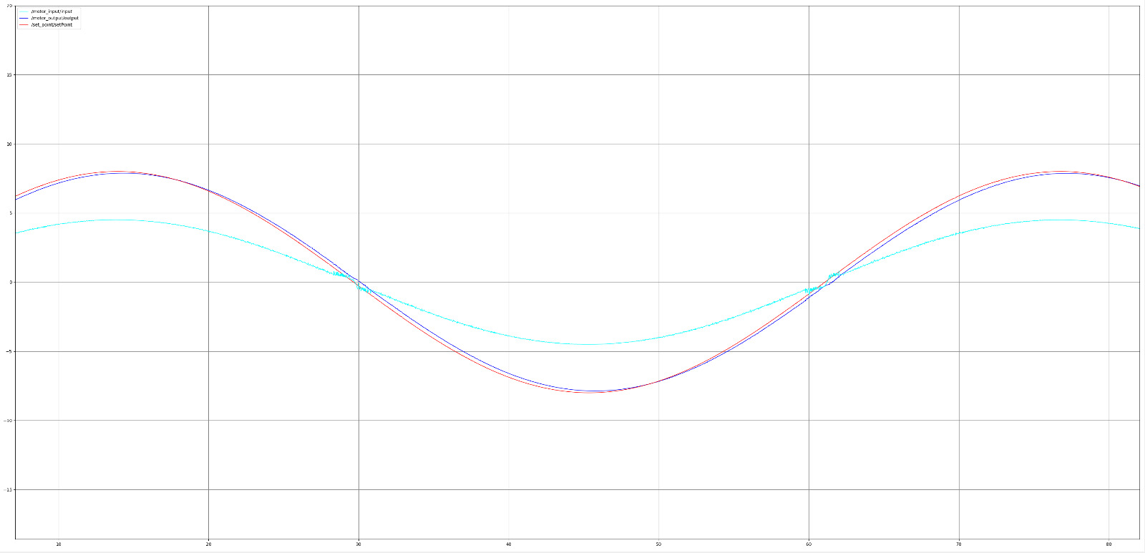
Mini Challenge 2 (Extension)
Expected results
Nodes used for this exercise
Output (blue) Following the Set Point (red) and control signal (cyan)

Slide 9
Rules
This is challenge not a class. The students are encouraged to research, improve tune explain their algorithms by themselves.
MCR2(Manchester Robotics) Reserves the right to answer a question if it is determined that the questions contains partially or totally an answer.
The students are welcomed to ask only about the theoretical aspect of the classed.
No remote control or any other form of human interaction with the simulator or ROS is allowed (except at the start when launching the files).
It is forbidden to use any other internet libraires with the exception of standard libraires or NumPy.
If in doubt about libraires please ask any teaching assistant.
Improvements to the algorithms are encouraged and may be used as long as the students provide the reasons and a detailed explanation on the improvements.
All the students must be respectful towards each other and abide by the previously defined rules.
Manchester Robotics reserves the right to provide any form of grading. Grading and grading methodology are done by the professor in charge of the unit.

